Slide 1



Atliq Hospitality Business Insights

Slide 2

Significant revenue lost
15% loss in revenue is very significant, we need to understand why there are too many cancellations in bookings in turn loss in revenue.

Slide 3
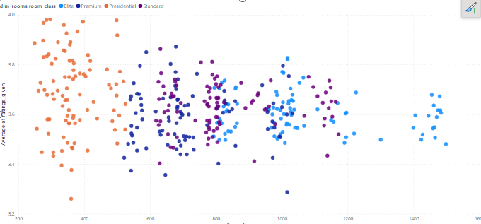
Customer Ratings
The service or the customer satisfaction gap is huge for presential rooms as compared with other rooms, as the ratings are not much wide. This indicates a gap in the service quality.

Slide 4
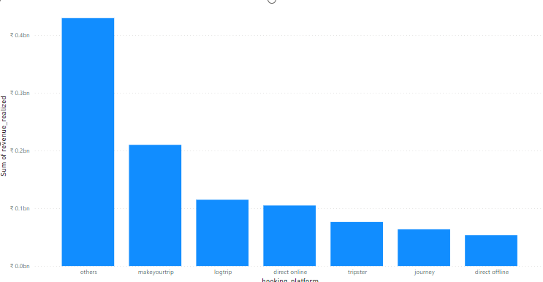
Revenue Generation Media
More than 40% of the revenue comes from ‘Others’. We need to delve deeper to understand which platforms contribute the most revenue. This will help us create effective media plans that drive bookings and, in turn, generate more revenue.

Slide 5
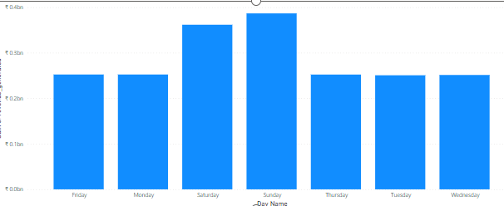
Revenue Generation weekday vs weekend
There is a scope to increase revenue during the weekdays by giving offers, coupons,
And other forms of attractive deals to lure customers.
Dynamic pricing on weekends helps to increase revenue.

Slide 6
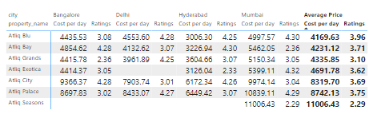
Atliq Seasons Expansion
The average cost per room for Atliq seasons is Rs. 11,006 which is the highest among others. But it is present only in Mumbai and needs expansion in other cities to increase revenue.

